Slide 1
Customer Segmentation using rfm
Nabila Pindya

Slide 2
Analysis flow
Pre-Processing
Exploring Data
RFM
CLV (BG/NBD Model)
Recommendation

Slide 3
Data Understanding
Data is taken from Kaggle
It is consist of 813658 data with 8 columns.
This data is about purchasing data of online retail that available in some countries.
Data Dictionary
UserId : Customer number that consist 6 number
TransactionId : Number of Transaction for every purchases
TransactionTime : Time when the transaction happen that consist Date and hour
ItemCode : Code for product
ItemDescription : Name of the item
NumberOfItemsPurchased : Quantity of product per purchase
CostPerItem : Price per Item
Country : Place where the customer did the transaction

Slide 4
PRIMARY GOALS
Get business insight
Top 10 Products that sold the most
Top 10 Countries that purchased the most
Total of product sold every month
Total of sales every month
Customer Segmentation with RFM
Customer Lifetime Value (CLV)
Purchases Predict in the Future
Recommendation based on customer segmentation.

Slide 5
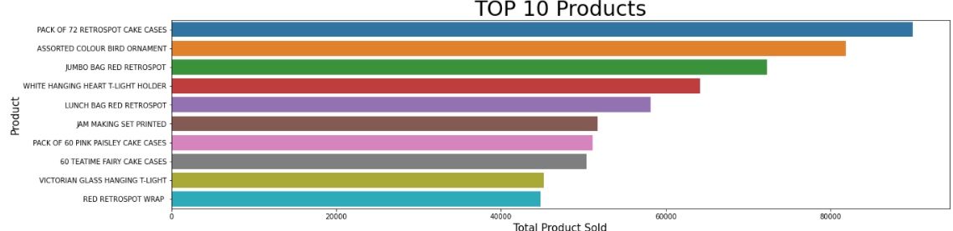
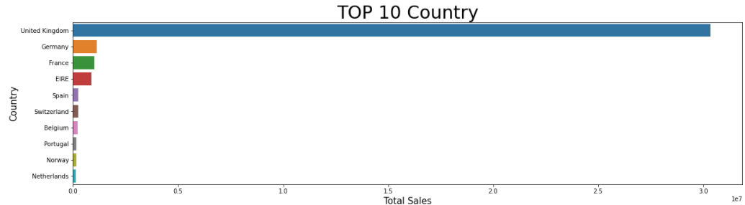
TOP 10 PRODUCTS AND COUNTRIES
During one year transaction, Pack of 72 Retrospot Cake Cases has been the most product sold with more that 80000 pieces followed by Assorted Color Bird Ornament in the second place.
United Kingdom place in the first for country that did most purchased and it has big different amount with Germany who in second place.

Slide 6
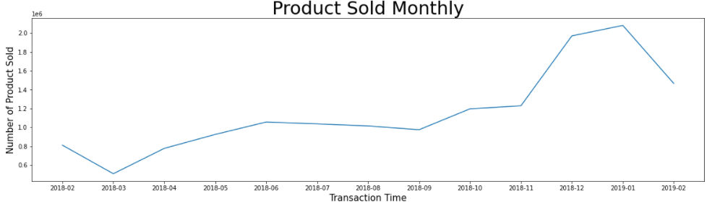
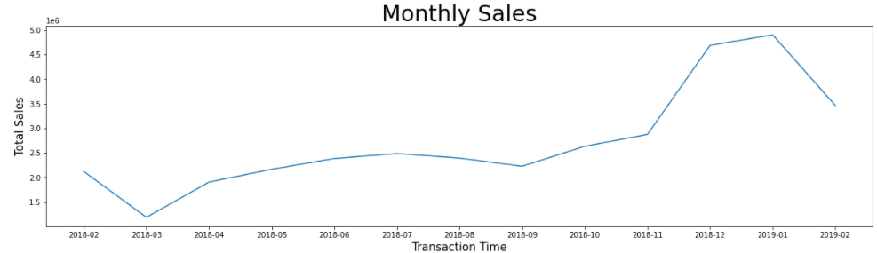
Product sold monthly and monthly sales
For the product sold monthly and monthly sales it has the same graphic that can be seen beside. The lowest amount was happen on March 2018 and the highest amount was on January 2019

Slide 7
Recency. Frequency and monetary value (rfm) Analysis
RFM is a method of customer analysis and segmentation based on their shopping habits.
Recency : How recently customer did the transaction
Frequency : How often the customer make the transaction
Monetary : How much money they spend
Customer Segmentation
Champions : best customers, who bought most recently, most often, and are heavy spenders
Loyal Customer : Customers who buy the most often from your store
Potential Customer : Recent customers with average frequency and who spent a good amount
Promising : Customers who return often, but do not spend a lot
New Customer : customers who have a high overall RFM score but are not frequent shoppers
Can’t Lose Them : customers who used to visit and purchase quite often, but haven’t been visiting recently.
At Risk : customers who purchased often and spent big amounts, but haven’t purchased recently
Hibernating : Last purchase was long back.

Slide 8
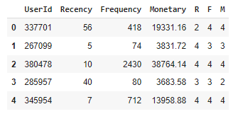
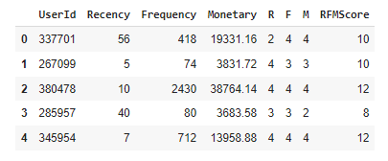
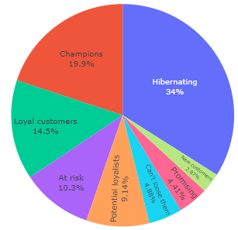
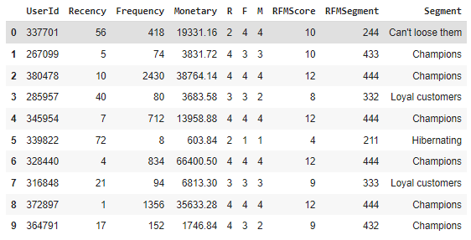
Recency. Frequency and monetary value (rfm) Analysis
Customer Segmentation Distribution
RFM Score
RFM Total Score
RFM Segmentation
From this graph, it can be seen that many of the customer is in Hibernating Status with 34% which means the did last purchase was long back and in the second place is Champions with 19.9%

Slide 9
Customer Lifetime value (CLV)
Metric of CLV
Recency : How recently customer did the transaction
Frequency : How often the customer make the transaction
Monetary Value : the mean of a given customers sales value
T : Age of the customer (End of Period Analysis – FirstTransaction)
CLV Formula:
CLV = ((Average Order Value x Purchase Frequency)/Churn Rate) x Profit margin.
CLTV = Average Order Value * Purchase Frequency

Slide 10
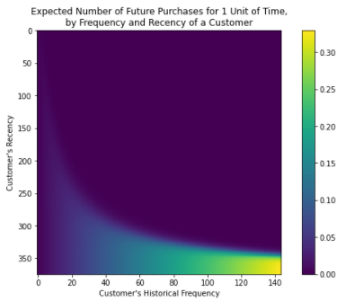
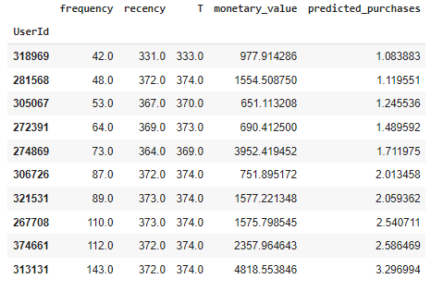
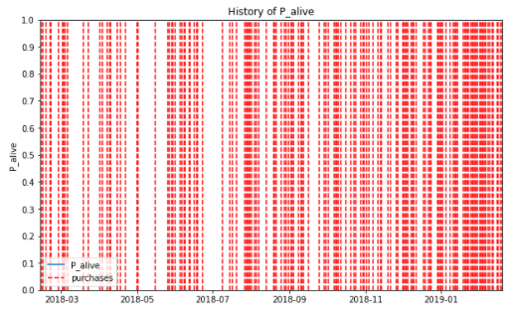
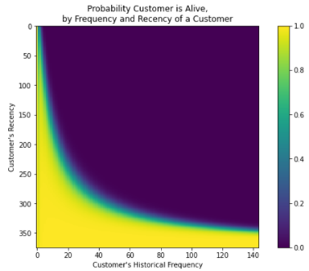
Frequency/Recency Analysis Using the BG/NBD Model
Customer transactions predictions
the probability of customer being alive
from this we can see when a customer has made 140 purchases, and their latest purchase was they were approximately 350 days old (Recency: 350 days), then they are our best customer (bottom-right).
from the table above we can see top 10 customer that expected to make purchases in the next 10 days
The predicted_purcahses columns is represent the expected number of purchases that customer will make in the future. The BG/NBD model believes that the customer will make more purchases in the future since they are our best customer
From this graph can be seen that the customer with UserId = 313131 is being inactive
Customers who have purchased recently are probably “alive”.

Slide 11
RECommendation
Hibernating : Rebranding value. Offer relevant products and give good offers
Champions : Give Loyalty Rewards or give chance for them to try new product
Loyal Customer : Sell higher value products and ask for their review to know more about their experience
At Risk : Send email blast to reconnect to them and give product recommendation
Potential Royalist : Give product recommendation and loyalty reward to engage them
Can’t Lose Them : Give special offer to them to make them feel valuable again
Promising : Make brand awareness
New Customer : Start building relationship by provide good experience

Slide 12
Thank you
Nabila Pindya
nabilapindya@gmail.com

